Slide 1

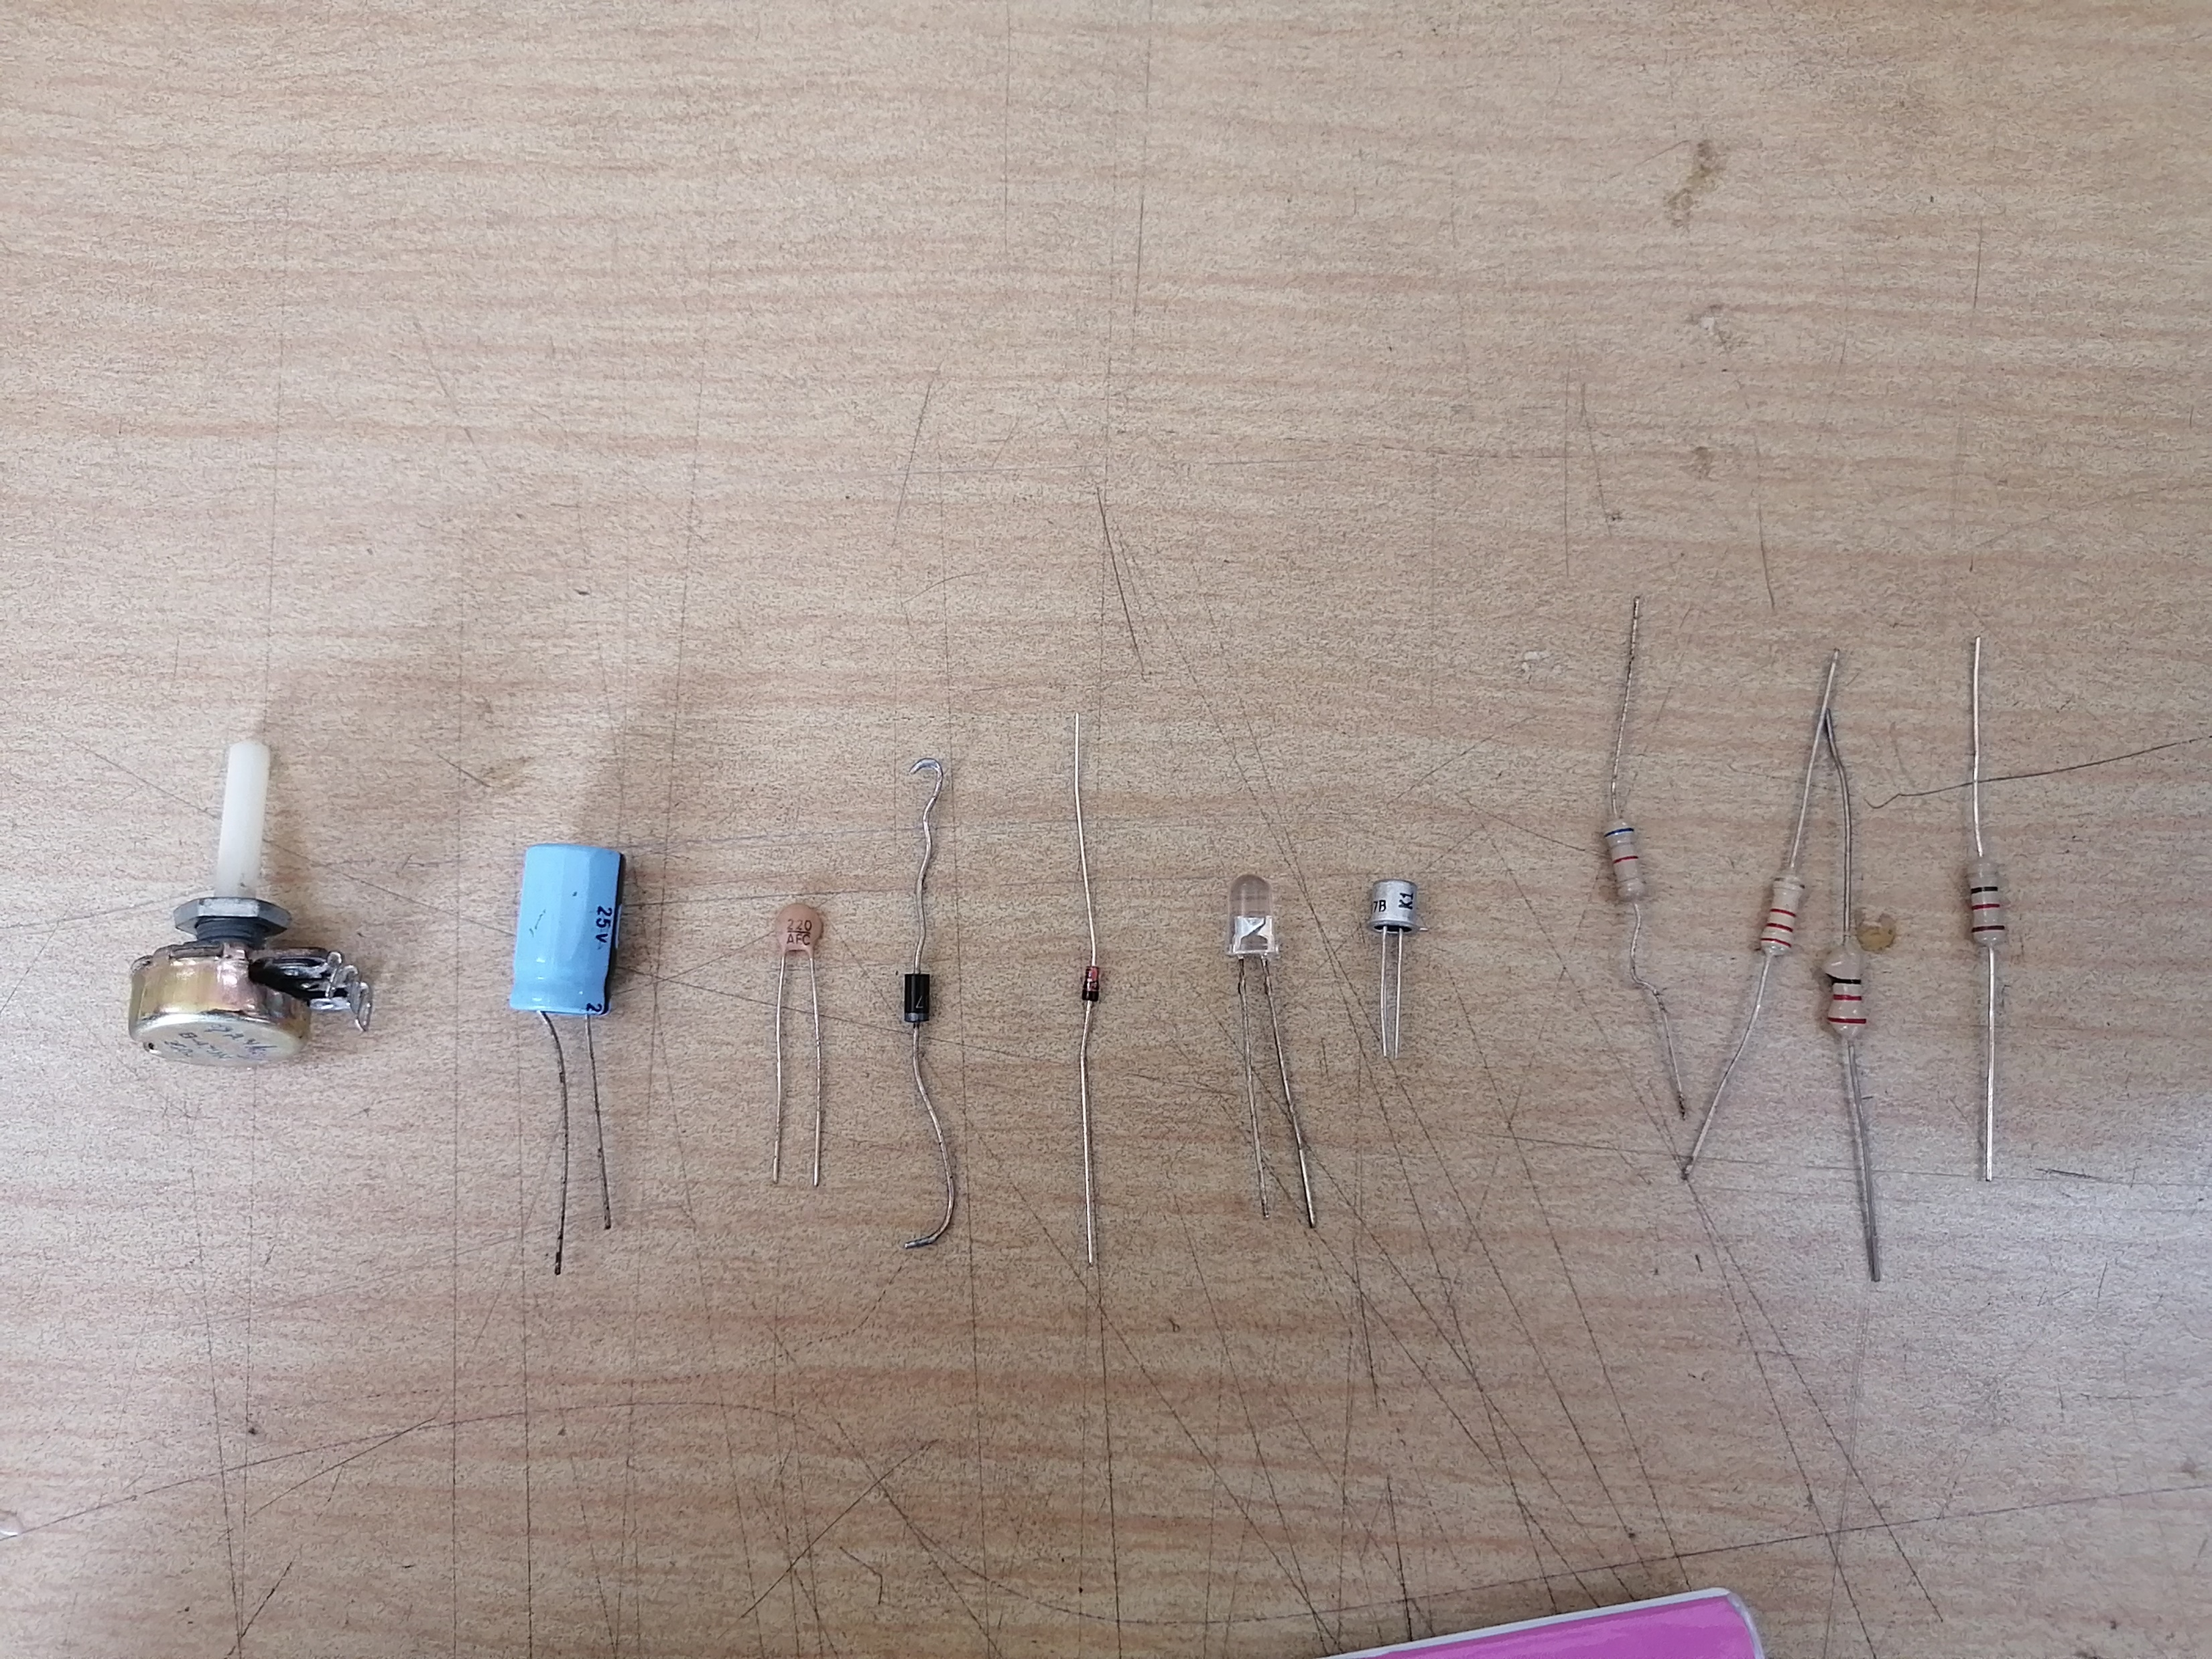
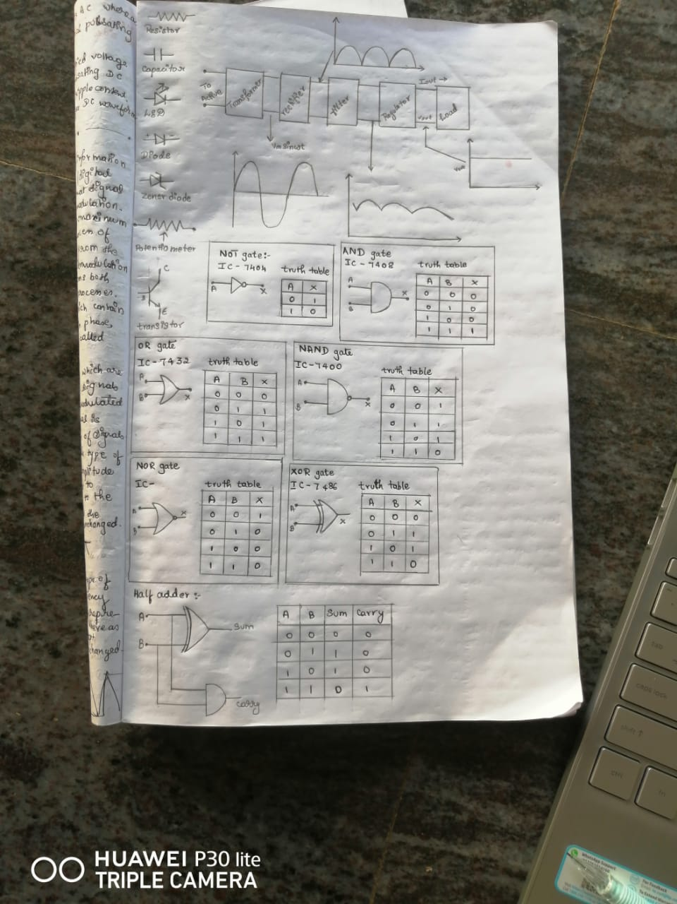
St. Joseph Engineering College Mangaluru
Summer Internship-I
Oct-Nov 2022
Name: K. Shravya Shetty
USN: 4SO21CS072
Branch: Computer Science And Engineering
Section: CSE-B
Mentor: Dr. Harivinod N
Electronics And Communication Engineering

Slide 2
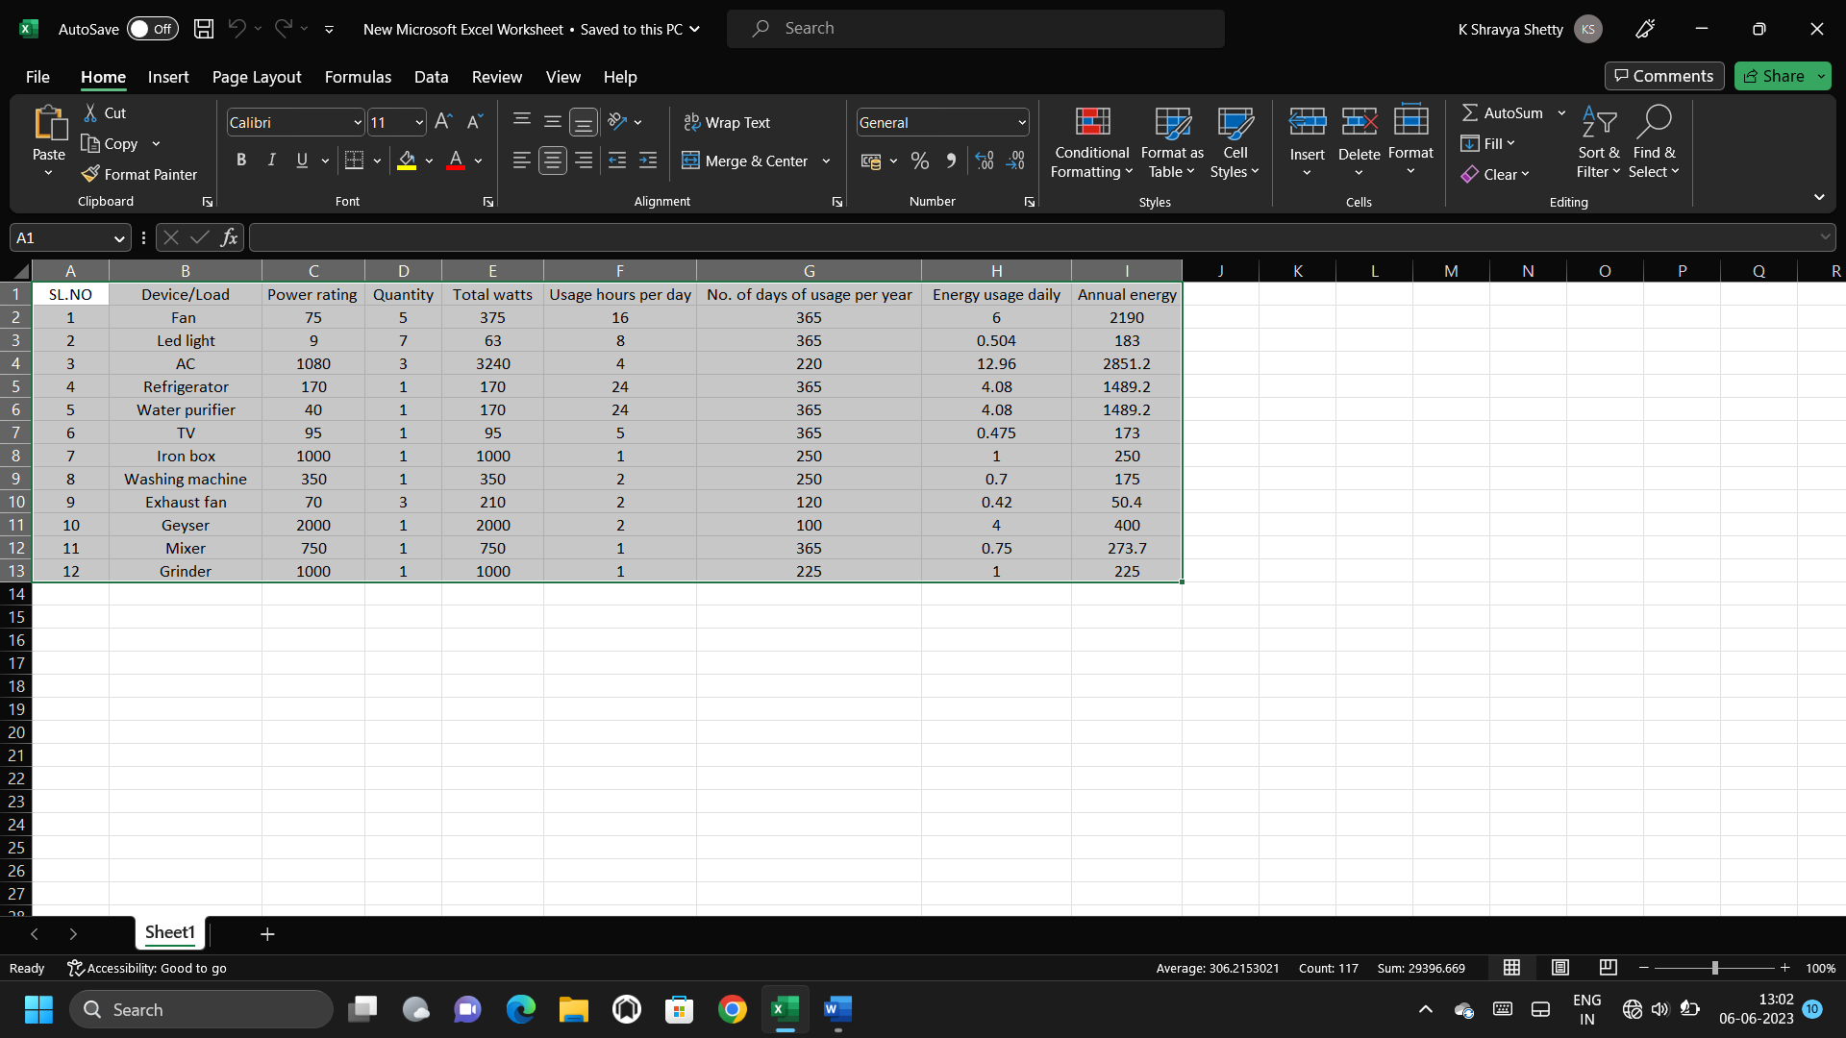
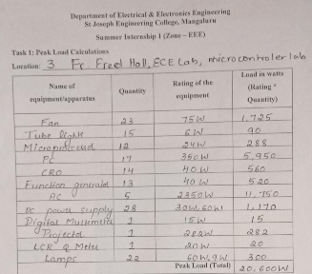
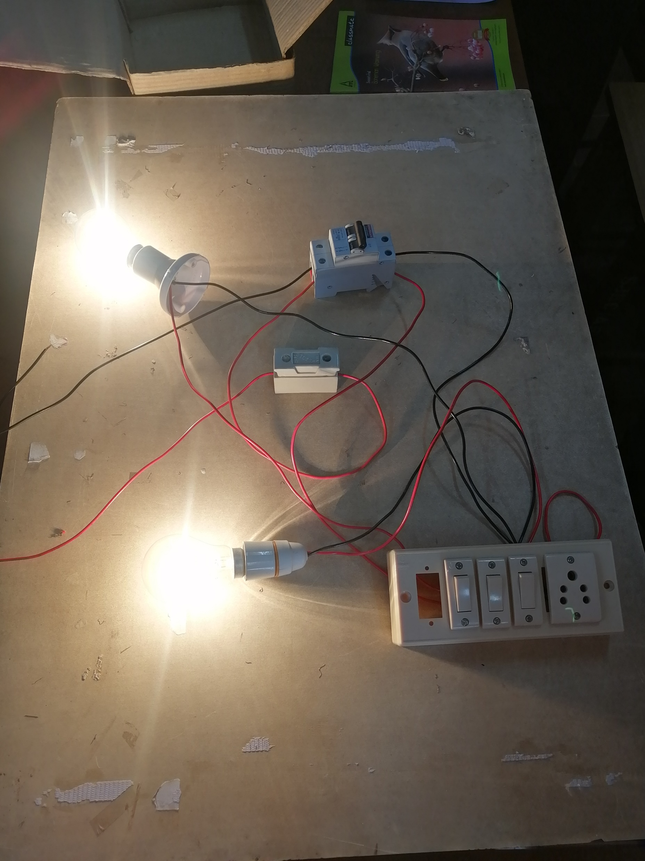
Electrical And Electronics Engineering
Electronics And Communication Engineering
Summary of the things learnt:
To identify different parts and their application: Resistor, Capacitor,
Colour coding the resistors.
Different types of modulation: Amplitude modulation, Frequency modulation, Phase modulation.
Summer Internship-I
Oct-Nov 2022
Name: K. Shravya Shetty
USN: 4SO21CS072
Branch: Computer Science And Engineering
Section: CSE-B
Mentor: Dr. Harivinod N
To study the working of logic gates: Not gate, And gate, Or gate.

Slide 3
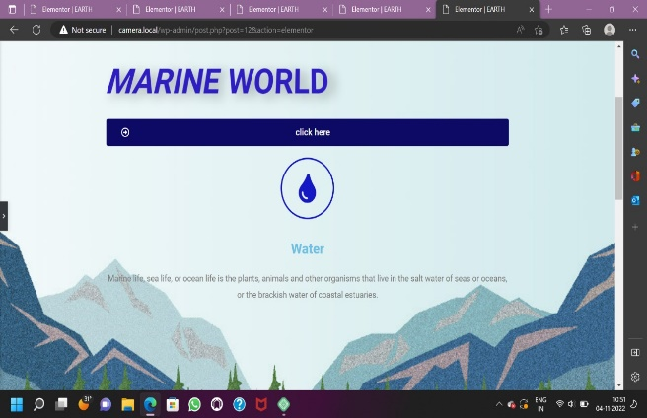
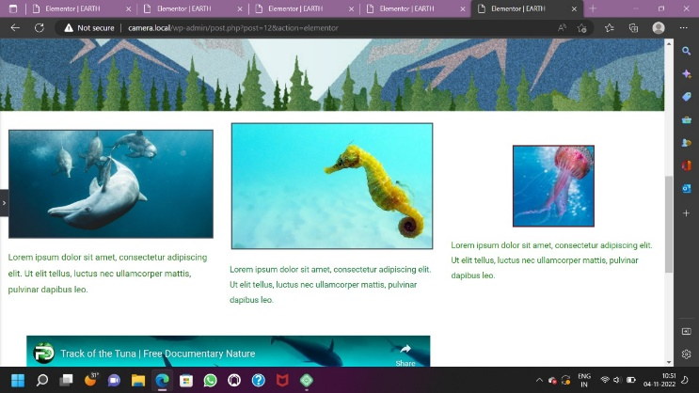
Computer Science And Engineering And ICBS
Electronics And Communication Engineering
Electrical And Electronics Engineering
Summary of things learnt:
To calculate peak load
Wiring practice
Apparatus investigation

Slide 4
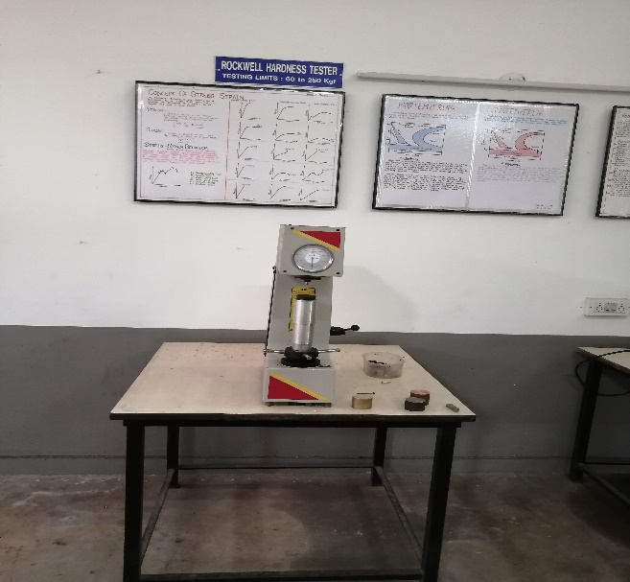
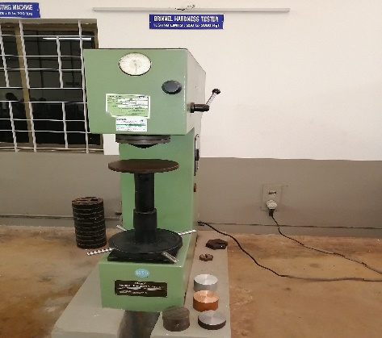
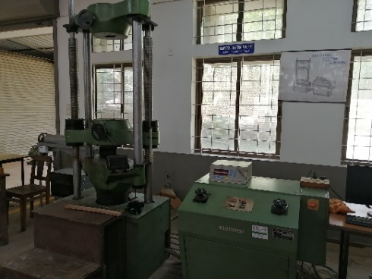
Electrical And Electronics Engineering
Mechanical Engineering
Computer Science And Engineering And ICBS
Summary of the things learnt:
Basics features of Word press
Advantages of Word Press: Easy to set up, Quick installation, Mobile-Friend
People who use Word Press

Slide 5
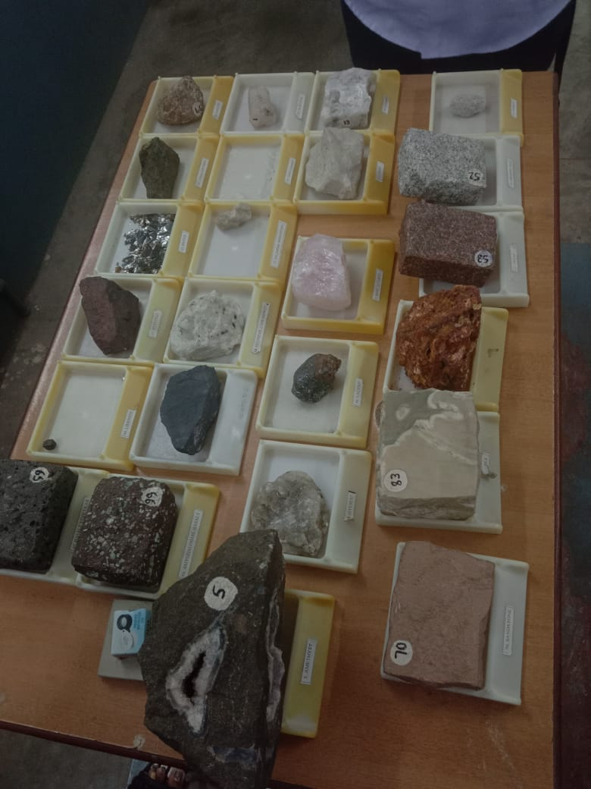
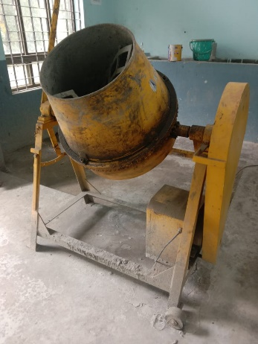
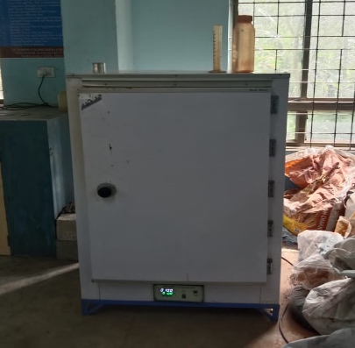
Electrical And Electronics Engineering
Mechanical Engineering
Summary of things learnt:
Lathe Operations:: drilling and thread cutting etc.
Milling Operations: Gear Cutting using Milling machine
Foundry and Forging
Material Testing : Destructive test, Non destructive test.
Fluid Mechanics : Working of Pelton wheel.

Slide 6
Mechanical Engineering
Civil Engineering
Summary if things learnt:
Basics of geology: Soil formation, rock formation, identification of rock minerals by their properties
Introduction to Geotechnical Engineering
CAD Software
Introduction to concrete lab and the experiments
Survey lab

Slide 7
Conclusion
This summer internship provided a hand on experience on wiring practice, apparatus investigation, designing a website using word press, foundry and forging, knowledge about the lathe and milling machines, surveying and knowledge about geology.

